Slide 1

Compilation Visualizer for Neutral-Atom Gate-Based Quantum Computers
Quinn Manning
Daniil Shatokhin
Kevin Li
David Nizovsky
Dmitrii Khitrin

Slide 2
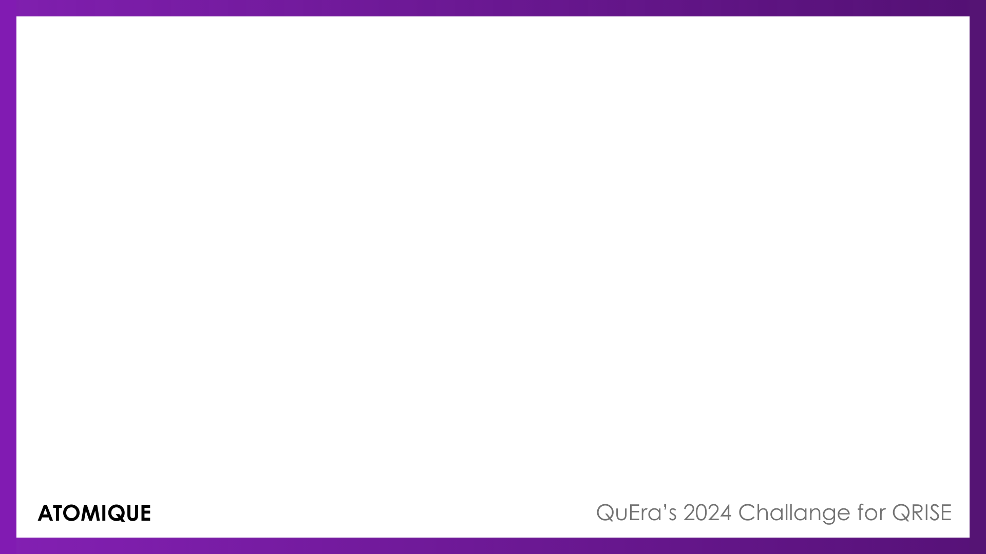
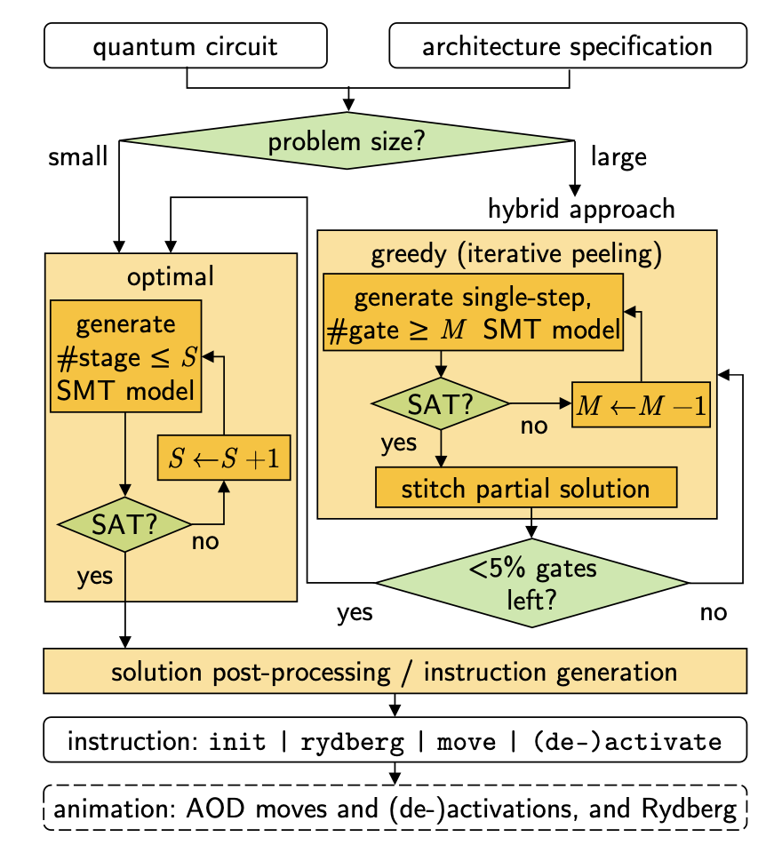
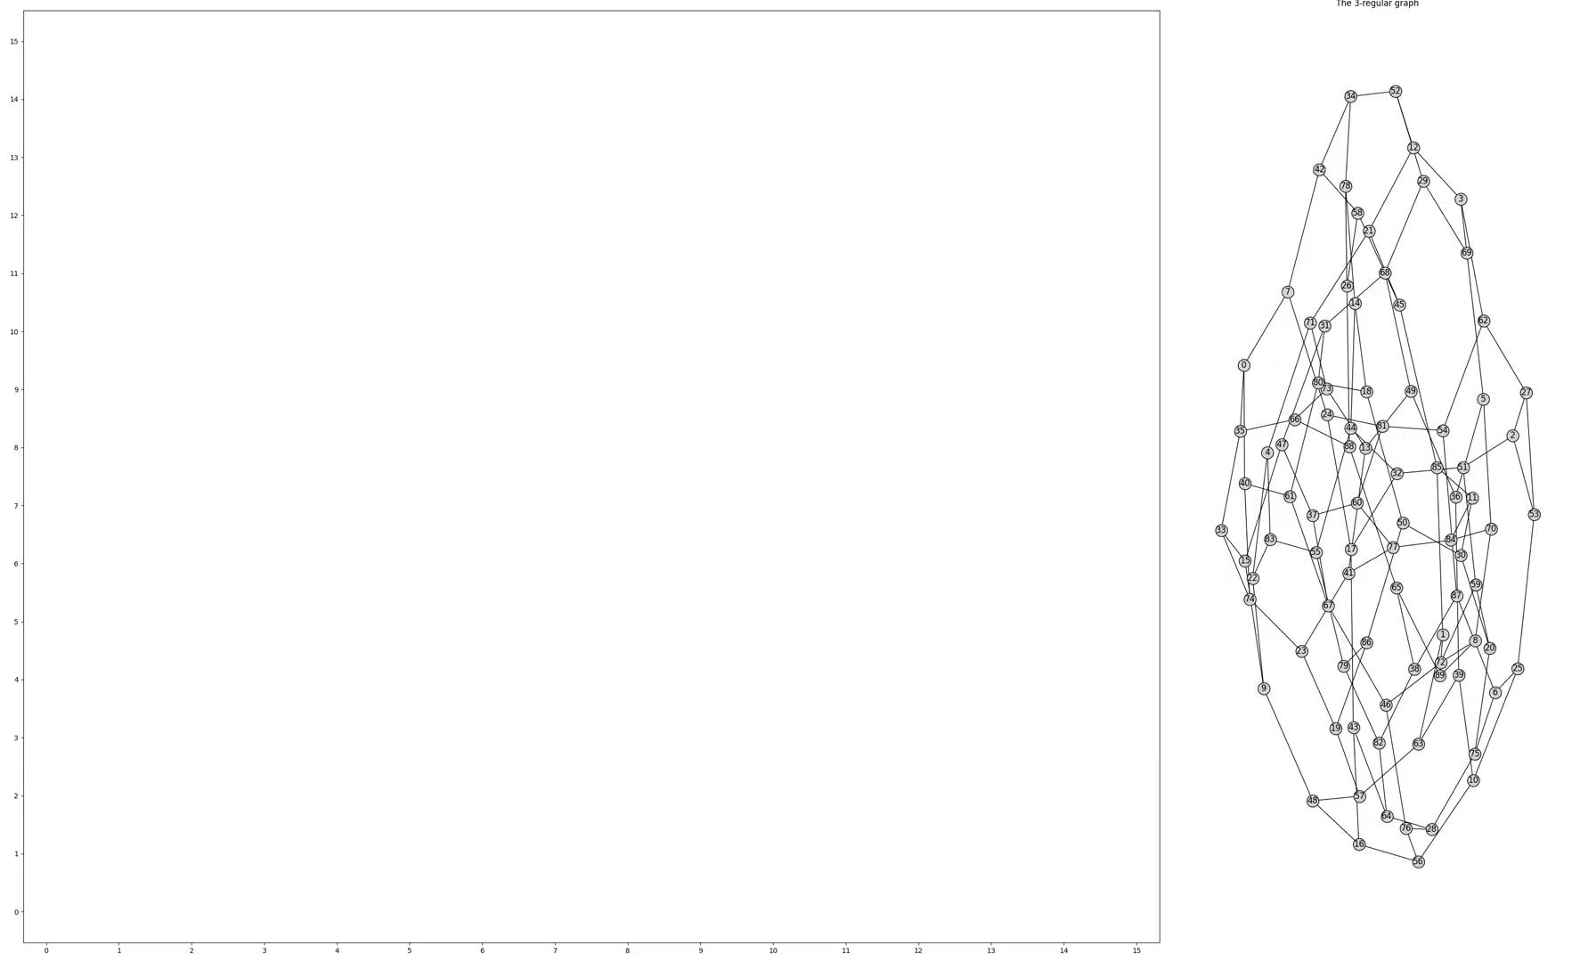
Previous Work
Tan, D.B., Bluvstein, D., Lukin, M.D. and Cong, J., 2024. Compiling quantum circuits for dynamically field-programmable neutral atoms array processors. Quantum, 8, p.1281.

Slide 3
Algorithm Outline
Input quantum circuit object
Decompose circuit
Run SMT to find efficient solution to implementation on atom array
Implement single-qubit gates
Implement Steane code
Implement stabilizer measurements
Animate

Slide 4
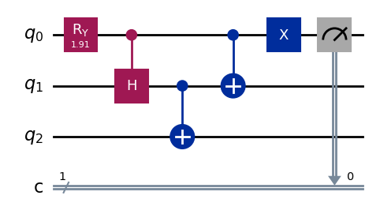
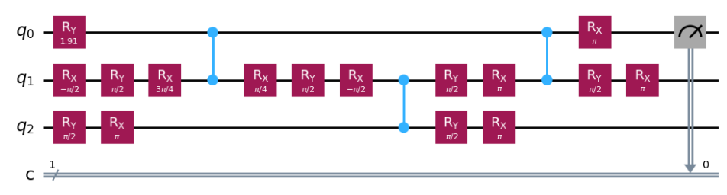
Transpiling Quantum Circuits
Decomposes universal quantum circuits into circuits consisting of only native neutral atom gates via Qiskit Transpiler
Our native gate set:
Example, 3 qubit W state circuit decomposition:
Rx
Ry
CZ

Slide 5
Satisfiability Constraints
An AOD row/column cannot cross over another AOD row/column
Arbitrary single-qubit gates can be applied individually
Two-qubit gates are only applied when q0 and q1 are within the Rydberg blockade radius
Conclusion: we load two-qubit gate set into SMT solver and re-introduce single-qubit gates later

Slide 6

Animating Single-Qubit Gates
Gates can be driven by a Rabi frequency and detuning frequency pulse
By the area theorem, we assume that the integral of the Rabi frequency over time is equivalent to the angle of rotation
We can thus compute the duration and maximum frequency of pulses and report these values next to the corresponding qubit in the array

Slide 7
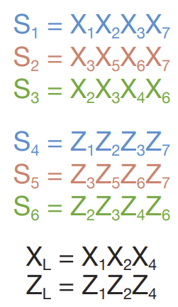
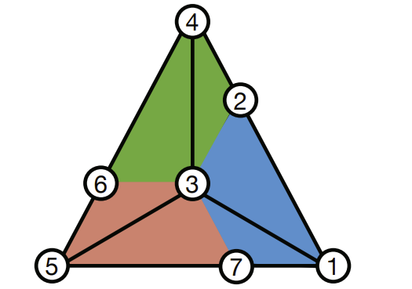
Implementing Steane Code

Slide 8
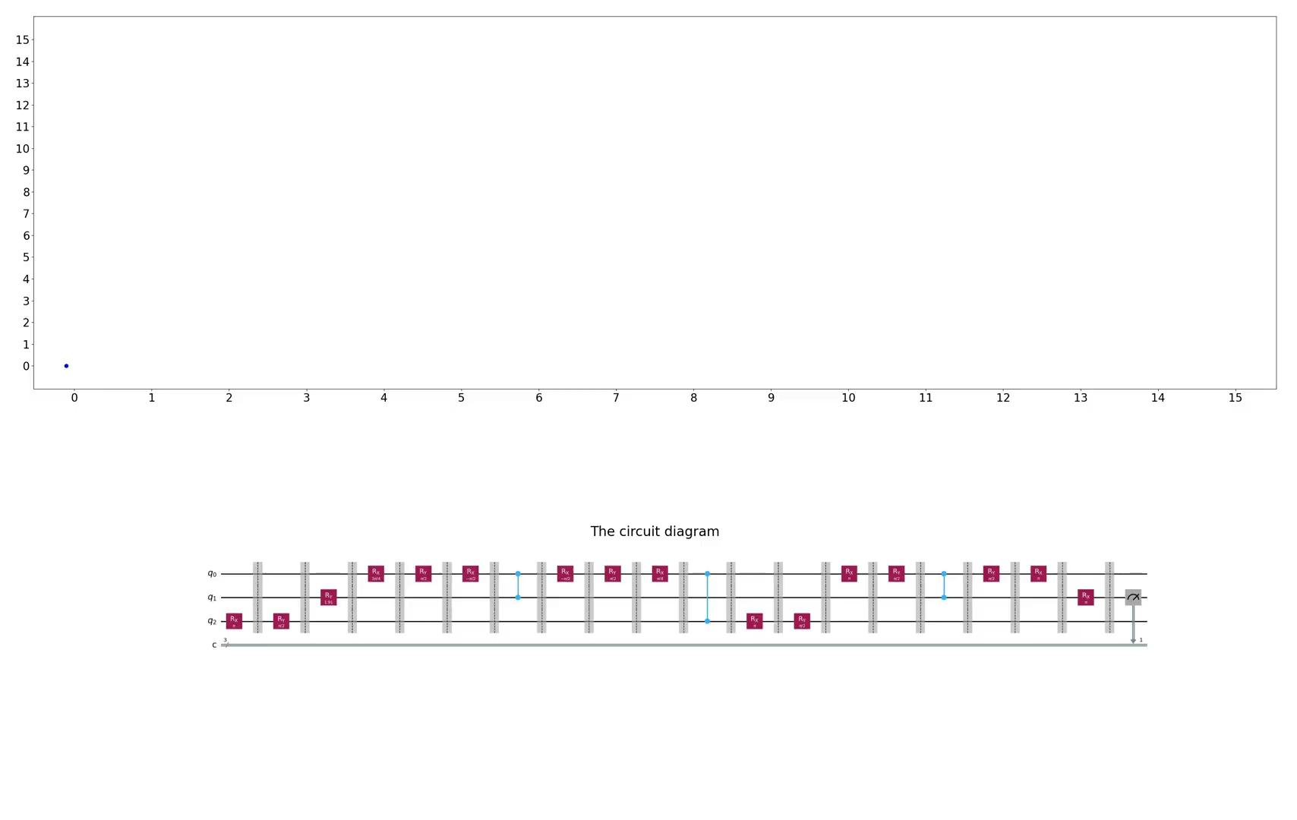
Animating the Compiled Circuits
Circuit execution visualization
Single-qubit rotations
Raman pulse parameters
Measurements

Slide 9
Final Remarks
Input quantum circuit object
Decompose circuit
Run SMT to find efficient solution to implementation on atom array
Implement single-qubit gates
Implement Steane code
Implement stabilizer measurements
Animate

